Slide 1
Lecture 16 – Simulation and Monte Carlo analysis

Slide 2
Monte Carlo Methods
A Monte Carlo method is a computational algorithm which relies on repeated random sampling to compute its results. Monte Carlo methods are often used when simulating physical and mathematical systems. Because of their reliance on repeated computation and random or pseudo-random numbers, Monte Carlo methods are most suited to calculation by a computer. Monte Carlo methods tend to be used when it is infeasible or impossible to compute an exact result with a deterministic algorithm
There is no one Monte Carlo method; instead, the term describes a large and widely-used class of approaches. However, these approaches tend to follow a particular pattern:
  Define a domain of possible inputs.
  Generate inputs randomly from the domain, and perform a deterministic computation on them.
  Aggregate the results of the individual computations into the final result
Wikipedia

Slide 3
Monte Carlo in Systems Engineering
Typically used in
  Establishing design environments
  Predicting end to end performance
    Particularly used in trajectory and flight control simulations

Slide 4
Monte Carlo Methods – Stochastic methods
Parameters in the real world don’t always take on an exact value
Normally they take on a distribution of values
For example
  If we fired 100 solid rocket motors
  They wouldn’t fire exactly the same every time
    Variations in propellant composition, propellant layout, shedding of material, internal acoustics result in small but important thrust variations
  And measured the thrust at each second of the firing
  We could build a mean and standard deviation to describe the thrust at every second of the firing
Another common problem is in estimating aerodynamic parameters
  You make many wind tunnel runs and observe the uncertainty in measurement of the parameters
  You then scale the model to flight and add uncertainty into that
If we know the mean and distribution, we can establish confidence over the maximum and minimum possible values
  99.1% probability of being within +/- 3 sigma (standard deviations)

Slide 5
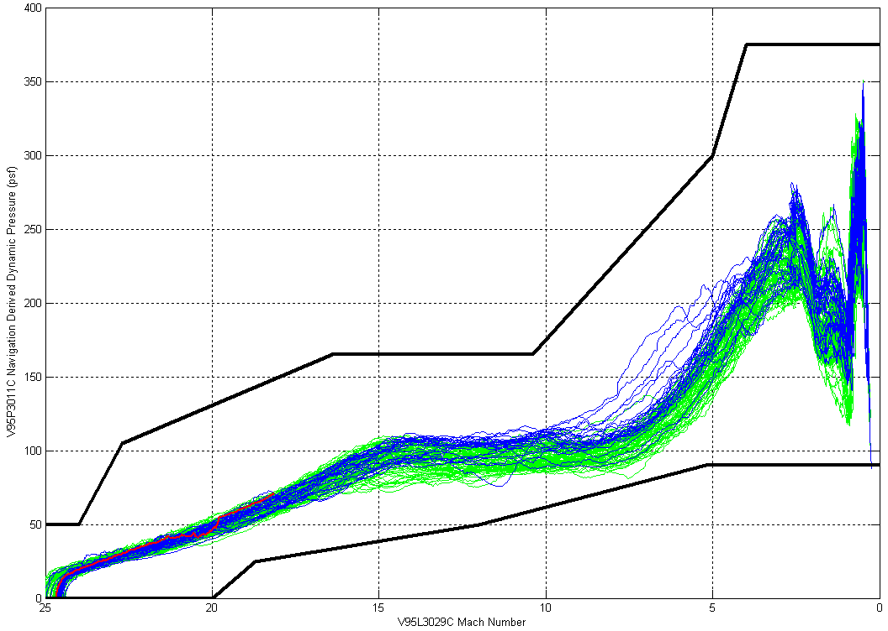
STS 107
Columbia Flights
Non-Columbia Flights
SODB Constraints (GN&C)
SODB Constraint (Structural)
Operational Constraints are from the Shuttle Operational Data Book (SODB) Volume V, Operational Flight Capability Envelopes and reflect current certified limits.
All Shuttle Flights Dynamic Pressure vs. Mach Number with Constraints
Notes:
This plot shows space shuttle entries back from orbit with a plot of dynamic pressure versus Mach number. The dark lines represent constraints which are basically conditions that represent vehicle breakup. Note that in the approximately 100 flights plotted here that there is a significant dispersion of trajectories that represent very different dynamic pressures at a given velocity (Mach number). This is the type of variation that Monte Carlo methods allow us to address.

Slide 6
Probabilistic Design
Probabilistic design is a discipline within Engineering Design
It deals primarily with the consideration of the effects of random variability upon the performance of an engineering system during the design phase.
Typically, these effects are related to quality and reliability.
Thus, probabilistic design is a tool that is mostly used in areas that are concerned with quality and reliability. For example, product design, quality control, systems engineering, machine design, civil engineering and manufacturing.
It differs from the classical approach to design by assuming a small probability of failure instead of using the safety factor to cover worst on worst combination of variables.
When using a probabilistic approach to design, the designer no longer thinks of each variable as a single value or number. Instead, each variable is viewed as a probability distribution.
From this perspective, probabilistic design predicts the flow of variability (or distributions) through a system.
By considering this flow, a designer can make adjustments to reduce the flow of random variability, and improve quality. Proponents of the approach contend that many quality problems can be predicted and rectified during the early design stages and at a much reduced cost.
Wikipedia

Slide 7
Use of Monte Carlo Methods in Design
Sometimes an engineering design is driven by a number of values to form the Design Limit Load (DLL)
When we combine the worst case values for all of the items contributing to the DLL we end up with a “Worst on Worst” (WOW) case design
Sometimes a WOW design is too heavy or impractical to implement
  Particularly true when larger driving values to a DLL are less likely
  If you take 3 sigma from four or five variables – you can end up with a composite 5 sigma or higher
In these cases, you turn to Monte Carlo methods to provide a better estimate of the DLL

Slide 8
General Flow
  Define a domain of possible inputs.
  Generate inputs randomly from the domain, and perform a deterministic computation on them.
  Aggregate the results of the individual computations into the final result

Slide 9

Monte Carlo Analysis for Evaluating the Effectiveness of Lightning Protection Systems at the LC-39 Launch Pads
Pedro J. Medelius, Ph.D.
Carlos T. Mata, Ph.D.
ASRC Aerospace Corporation
Kennedy Space Center
ASRC Aerospace Corporation
Notes:
This is an example of the type of problem attacked using Monte Carlo methods. Kennedy Space Center is locate din one of the highest lightning strike areas of the country. The lightning protection system on the pad, a series of towers and catenary wires, is very important to protecting the vehicle. The catenary system is dependent on the angles at which the lightning attaches to the pad. In this system, the lightning strikes were varied randomly to dtereine how well the protection system worked.

Slide 10
Monte Carlo Simulation
The following figures present the results of Monte Carlo simulations of the pads assuming that lightning leaders travel vertically with a step size 5% of their corresponding striking distances.
Strikes to ground are represented as “x” and strikes to objects of interest are represented as “o”.
Color code for all strikes with a peak current greater or equal than 100kA is presented with the same red intensity.
Colors of other peak currents correspond to the color bar shown in each figure.

Slide 11
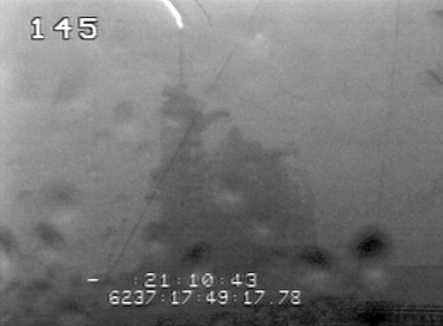
Notes:
Example of a lightning strike at the top of the lightning mast on the pad.

Slide 12
Monte Carlo Simulation
Case 1. Orbiter in launch configuration: RSS rotated back, GOX vent arm rotated back. Monte Carlo Simulation: 1000 years, 17 strikes per year
Vertical Leaders
ET received 52 strikes (0.3 %)
MLP received 5 strikes (0.0 %)
FSS received 6 strikes (0.0 %)
Catenary received 1987 strikes (11.7 %)
pad_surface received 428 strikes (2.5 %)
SRBs received 11 strikes (0.1 %)
Orbiter received 0 strikes (0.0 %)
rss_not_in_place received 1 strikes (0.0 %)
Previous Case 1 max 30º
ET received 129 strikes (0.76%)
MLP received 6 strikes (0.04%)
FSS received 18 strikes (0.11%)
Catenary received 5101 strikes (30.01%)
pad_surface received 182 strikes (1.07%)
SRBs received 36 strikes (0.21%)
orbiter received 0 strikes
rss_not_in_place received 5 strikes (0.03%)
Strikes to vehicle stack (SRBs, ET, Orbiter):
1 strike every 16 years
Strikes to vehicle stack (SRBs, ET, Orbiter):
1 strike every 6 years

Slide 13
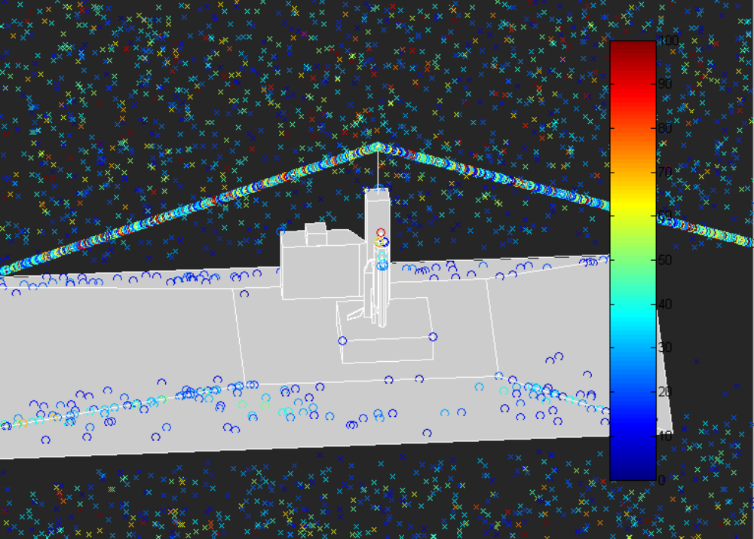
Monte Carlo Simulation
Case 1. Orbiter in launch configuration: RSS rotated back, GOX vent arm rotated back. Monte Carlo Simulation: 1000 years, 17 strikes per year

Slide 14
Simple Example – Loads on a rocket during launch
Dynamic Pressure
+
Total
Load
Inertial Loads
Pressure Loads
All three of these loads have time varying components and stochastic components

Slide 15
Shapes of the Components – Variation in s Time
Dynamic pressure starts low, increases as velocity increases, then decreases as atmospheric density decreases
q
Time
Inertial Loads are high initially as thrust is usually highest at liftoff, They decrease as the engines are throttled or solid rockets burn out, they typically rise again towards the end of flight as vehicle weight reaches minimum
g
Time
Pressure loads (internal versus external)
Rise as external static pressure decreases and then are constant as external pressure goes to vacuum
Delta P
Time

Slide 16
Distribution of values
Within any given time slice, there is a distribution of value that each variable can take
For example – the dynamic pressure is a function of density and velocity
  The density is a function of the atmospheric conditions at the time of launch
  The velocity at any altitude can be significantly dispersed by variations in thrust
Thus the dynamic pressure has a mean and standard deviation at every point in time across the flight profile

Slide 17
Shape of distributions – We use distributions to represent random variables in our Monte Carlo Simulation
Uniform
Normal
  the normal distribution provides a good model for a random variable, when:
    There is a strong tendency for the variable to take a central value;
    Positive and negative deviations from this central value are equally likely;
    The frequency of deviations falls off rapidly as the deviations become larger.
Weibull
  The exponential distribution is often used as a model of time-to-failure measurements, when the failure (hazard) rate is constant over time.
  When the failure probability varies over time, then the Weibull distribution is appropriate. Thus, the Weibull distribution is often used in reliability testing (e.g., of electronic relays, ball bearings)
Extreme Value
  The extreme value distribution is often used to model extreme events, such as the size of floods, gust velocities encountered by airplanes, maxima of stock marked indices over a given year, etc.; it is also often used in reliability testing, for example in order to represent the distribution of failure times for electric circuits

Slide 18
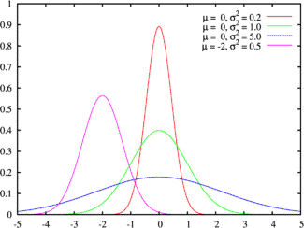
Figure 6A.6: Normal Distribution
http://pages.stern.nyu.edu/~ADAMODAR/New_Home_Page/StatFile/statdistns.htm
Notes:
Example of a Normal distribution with different mean and standard deviation values. The mean moves the location of the peak along the x axis and the standard deviation controls the width of the peak.

Slide 19
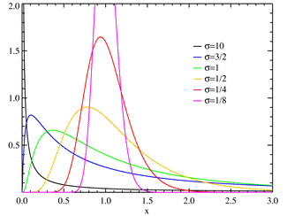
Figure 6A.9: Lognormal distribution
Notes:
Example of a lognormal distribution with different standard deviation values.

Slide 20
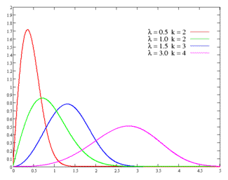
Figure 6A.10: Weibull Distribution
Notes:
A weibull distributuion. Note that with the lambda and k parameters, you can make almost any kind of distribution shape.

Slide 21
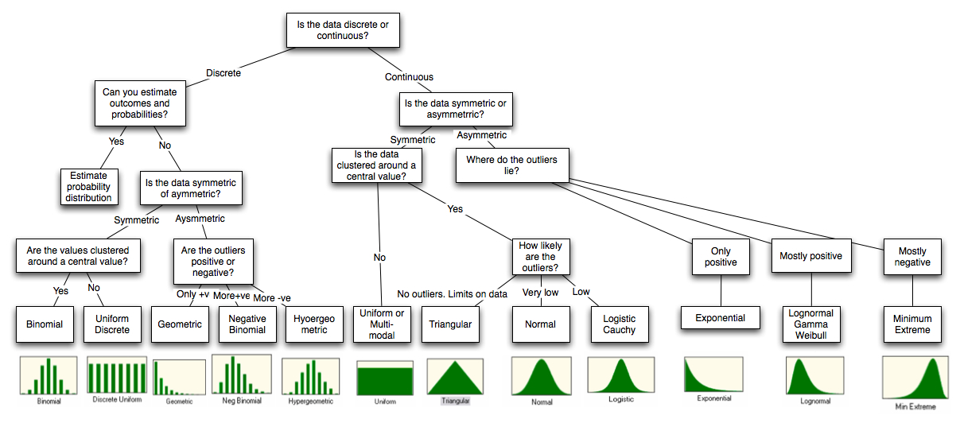
Figure 6A.15: Distributional Choices
http://pages.stern.nyu.edu/~ADAMODAR/New_Home_Page/StatFile/statdistns.htm
Notes:
Discrete distributions are those where there isn’t a continuous value. For example the distribution of sums of two dice is discrete. There is no way to get a 7.5 as the sum of two dice.
This diagram shows all of the types of distributions we can use the represent the random variables in a monte carlo simulation.

Slide 22
Example tossing 2 dice
Distribution is triangular and discrete
Value of 7 has maximum number of ways to achieve it
2 | 1-1
3 | 1-2 | 2-1
4 | 1-3 | 3-1 | 2-2
5 | 1-4 | 4-1 | 3-2 | 2-3
6 | 1-5 | 5-1 | 4-2 | 2-4 | 3-3
7 | 1-6 | 6-1 | 5-2 | 2-5 | 4-3 | 3-4

Slide 23
Implementing the Monte Carlo
Very simple implementation to illustrate the principle
For each run
  For each time slice
    For each of the three variables
      Use the LabVIEW random number generator to generate a uniformly distributed random number between 0 and 1
        Improvement would be to have a more realistic distribution like a normal or weibull
      Multiply this number by twice the selected confidence level (1,2, or 3 times the standard deviation reflecting 1, 2 or 3 sigma level of confidence)
      Subtract the selected confidence level (centers it about zero)
      Add to the mean
    This generates the selected value for random variable for this time slice
  Combine the variables to form the DLL for the time slice
Combine all the runs and generate statistics on the runs

Slide 24
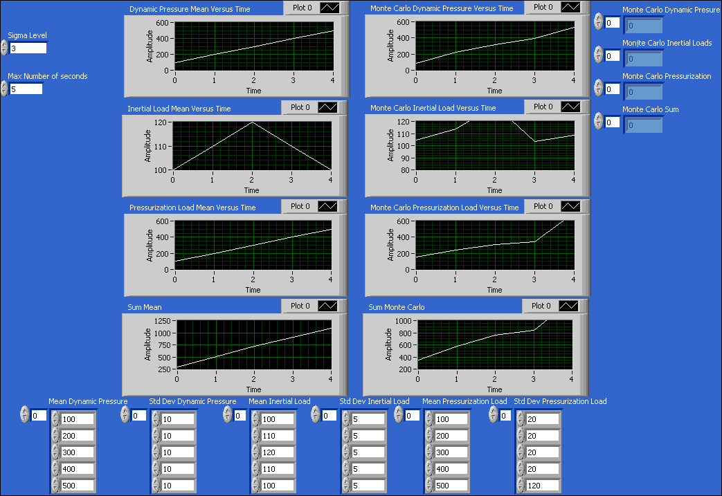
Example
Notes:
This shows the variable values chosen on a given single run

Slide 25
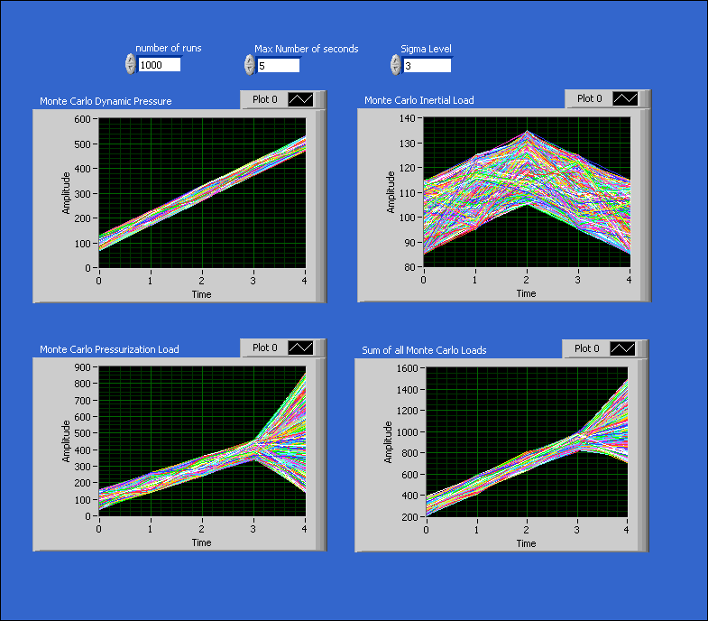
Notes:
This shows the effect of plotting all 1000 runs. The envelope that contains 99.9 percent of the runs is the 3 sigma confidence level.

Slide 26
Key Parameters
Degree of dispersion being protected
  Typically expressed in sigma
Number of runs
Variation in input mean and std deviation – sensitivity analysis

